Slide 1
CommJ Tutorial

Slide 2
CommJ Conversations
One-Way Send
One-Way Receive
Request-Reply
Multistep Conversation

Slide 3
Message
Each protocol message extends from CommJ Message class
It has a:
Protocol
Role
Conversation
Message Identity

Slide 4
CommJ Architecture
Application-level Aspects
Reusable Aspect Library
Core CommJ Infrastructure
Universal Model of Communications

Slide 5
CommJ Architecture
Provides a theoretical foundation for providing communication joint points and contexts:
Joint points correspond to events, e.g. message send and receive
Messages have identify and can be part of a conversation
Conversations follow protocols
And more
Application-level Aspects
Reusable Aspect Library
Core CommJ Infrastructure
Universal Model of Communications

Slide 6
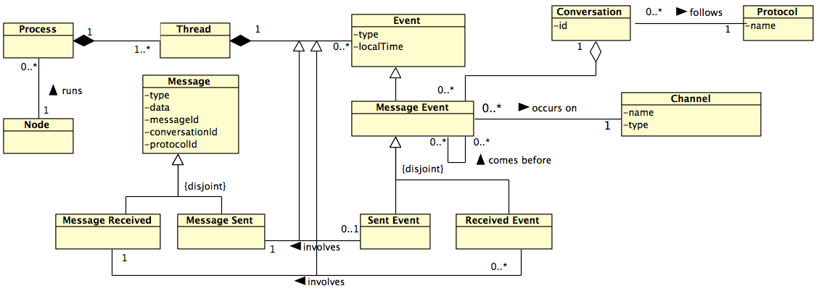
Universal Model of Communications
UML representation for part of the Universal Model of Communications (UMC)

Slide 7
CommJ Architecture
Implements classes for
representing communication contexts
trackers and monitor for managing these contexts
handling application-specification message identifying information
Defining common and application-specific protocols
Application-level Aspects
Application-level Aspects
Reusable Aspect Library
Implements base aspects for weaving comm. advice
Core CommJ Infrastructure
Universal Model of Communications

Slide 8
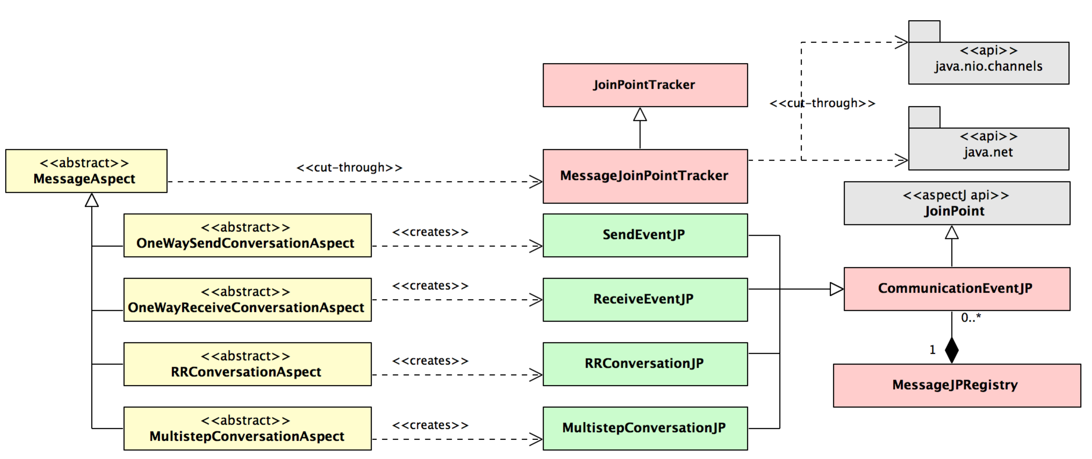
Core CommJ Infrastructure
UML representation of CommJ’s core infrastructure

Slide 9
Core CommJ Infrastructure
Implemented as Aspects
UML representation of CommJ’s core infrastructure

Slide 10
Core CommJ Infrastructure
Implemented as Classes
UML representation of CommJ’s core infrastructure

Slide 11
CommJ Architecture
Application-level Aspects
Reusable Aspect Library
Core CommJ Infrastructure
Implements a set of useful communications aspects, with applicability across a wide range of domains.
Universal Model of Communications

Slide 12
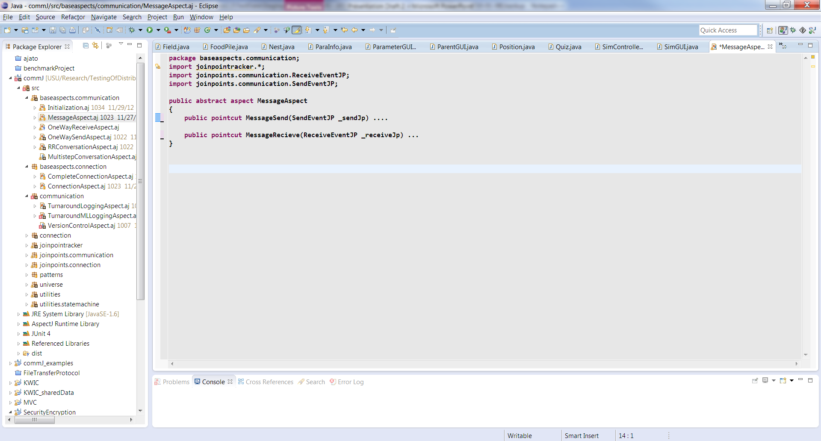
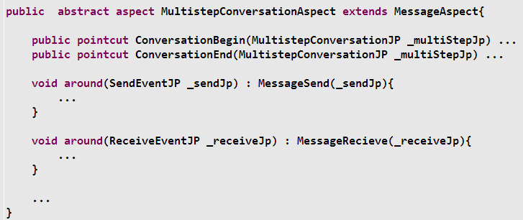
Code Snippets from CommJ

Slide 13
CommJ Architecture
Application-level Aspects
Reusable Aspect Library
Core CommJ Infrastructure
Aspects that implement custom communication CC’s – anything you can imagine!
Universal Model of Communications

Slide 14
Computing Conversation Time
Initial
Msg #1 sent
Waiting for response from Sue
T1
Msg #2 received
Got response from Sue
Conversation Time = TS2 – TS1
Msg #3 sent
Acknowledgement Received
T2
Waiting for acknowledgement from Bob
Msg #4 received

Slide 15
Important Instructions
Uses the following:
Log4J properties file
A utility package that contains:
Encoder
Root level Message class
Protocol Messages
CommJ developers need to delete the Encoder, Message class
An aspect folder
Containing the extension related classes and aspects

